Slide 1

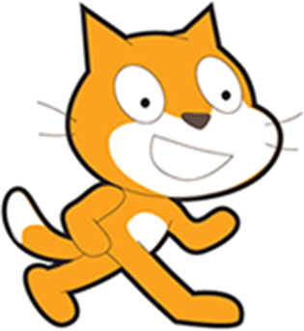

Time to do some programming
scratch.mit.edu
Warmup: “Rainbow Writing”
Introduce ‘Bat Away’. Make our bat.
Show the game loop. Keep the bat away.
Add some improvements…
Wrap up
CoderDojo October Studio
http://scratch.mit.edu/studios/261917/

Slide 2
Whoa, programming?
But, but, but..
So, can computers think?
(no)
Ok, can they be told what to do?
(psst, yes, and it’s called programming!)
Can they make decisions?
(yes)
How? We’ll dive into this today.
Notes:
Purple is my hint to you
Red is when I think you’re concerned

Slide 3
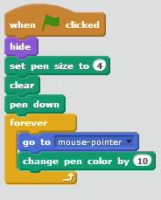
5 minute Warmup! “Rainbow Writing”
Go to scratch.mit.edu and sign in if you have an account.
“Rainbow Writing” demo of advanced version
Your mouse is the pen.
Make the writing follow the mouse.
Create a project, create a new sprite, paint it to be a dot of non-black.
Drag these script
blocks on to the sprite

Slide 4
Tonight (and beyond): Bat Away! (Ask yourself: “How can I use what he’s saying to write the game”)
First milestones:
A Bat flies around the stage
The player guards the bottom from the bat.
If the bat gets past the guard: GAME OVER
Here’s mine with just a few additions: scratch.mit.edu/projects/13203931/
Later milestones:
If the bat gets past the guard: the bat scores
At some time (say, after three scores), end the game.
As I talk, think about tricks for detecting that the player missed the bat? (Know one way? Find a second way to do it! TMTOWTDI)
(The trick I’m using is to have a sprite that is a line at the bottom,
and test if the bat touches that sprite.)

Slide 5
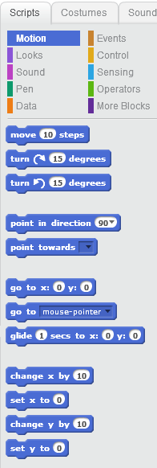
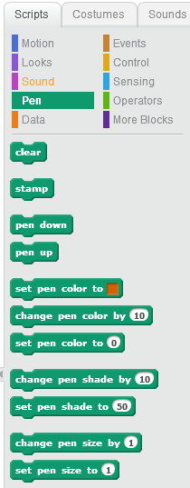
What can computers be told to do?
If you’ve used Scratch, you know some script types.
You just used these:
Drawing
Motion
Scratch Logo Demo
The next few slides show some of the other important script blocks.

Slide 6
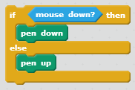
Computers is so stoopid!
Don’t do what I said, do what I want!!
We all wish it were that easy.
Programs take action on events or the result of decisions in tests
In Rainbow Writer, you probably wanted the pen to stop writing, but how?
I decided to say “Pen Down” when holding down the mouse button.
That test was my condition for not drawing.
So, How do I say what I want?
(6 quick slides ahead)

Slide 7
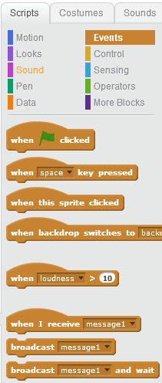
Events
The MOST USEFUL events are
When the Green Flag is clicked
When a keyboard key is pressed
When a sprite is clicked
What is useful for our project?

Slide 8
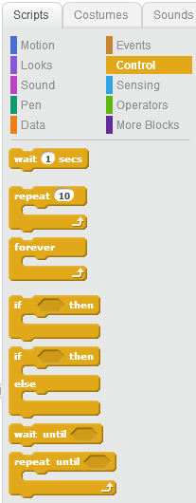
Controlling the actions
You are probably familiar with the basic controls
Wait for some time
Repeat Forever
Repeat a number of times
What is useful for Bat Away?
for playing the game?
for starting the game?
for making the bat fly?
Hey, what are those funny angled-things on the other controls?

Slide 9

Control by Conditional logic Typically test a condition
If <condition> then {
do this stuff
}
If <condition> then {
do this stuff
} else {
do that other stuff
}
Repeat until <condition> {
more stuff
}
What is useful for Bat Away?

Slide 10
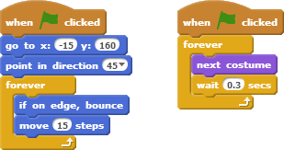
Let’s spend a few minutes starting your project!
Here are some art creation tips, and take a few moments to place some code that allows the bat to fly around the screen.
Use the Woods background
Add a sprite, like Bat2
Think of the bat as ‘the most important thing’ so you can minimize script elsewhere.
Add this script
http://youtu.be/ZXUEet92OnM

Slide 11
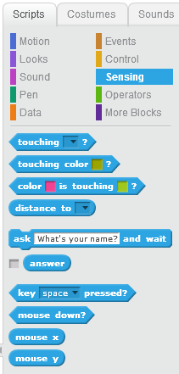
When the is right…
Those angled blocks are “what to test”
You can’t do a game without them
One type of condition is “sensing”
What might be useful for Bat Away?
TMTOWTDI – TimToady –
There’s more than one way to do it.
Another principal is DRY – Don’t Repeat Yourself

Slide 12
Sensing
What might be important to sense in Bat Away?
Touching ___?
Key ___ pressed?
Mouse Down?

Slide 13
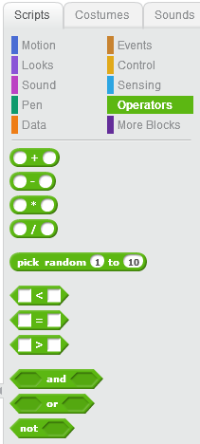
(optional) When the s ARE right
You can make more complex testing with operators (use AND, OR and NOT)
The < = and > operators work on numbers
Do you need these for PONG?

Slide 14
Bat Away – a few quick final words
Some missing parts:
Think of the bat as your ‘thing that does the tests, makes the decisions, and moves’ so you can minimize script elsewhere.
Start a paddle as a rectangular block. Later, the paddle can be decorated for Halloween. What do bats hate? FIRE? Wooden Stakes? Garlic? Have fun!
Add something to protect. I made a rectangle at the bottom and called it ‘scorezone’
Stuck? Look at http://scratch.mit.edu/projects/13203931/
- For fun, add scary sounds. My sounds are all “stock sounds”.
* You might use more than one background costume. I had a waiting screen ‘costume’, the Game Play costume, and the game over costume. Once you know messaging, then use a sprite that just has messages and use only one background.

Slide 15

Bat Away – the plan for your code
Design plan:
1) Get the paddle sliding only on the bottom. Code:
2) The bat shouldn’t fly until the player is ready. Tip: wait until the mouse is clicked, then start moving the bat.
3) Add ‘the game loop’ to the bat in another script block.
Tip: when the bat touches the paddle
4) In ‘the game loop’, if the bat touches what you are protecting, ‘end the game’ (or appear to!)
Watch: http://youtu.be/hx2FIxdi8lE
Checkpoint: http://scratch.mit.edu/projects/13203931/
Share yours to this studio: scratch.mit.edu/studios/261917/

Slide 16
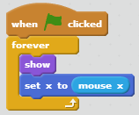
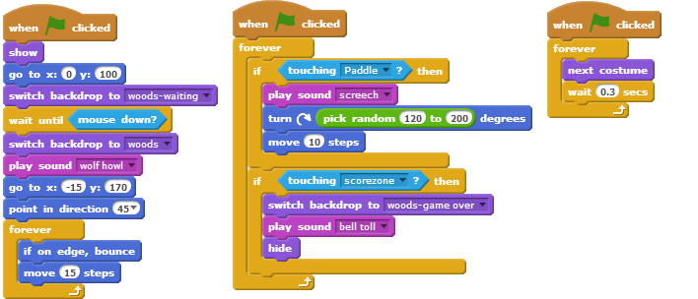
Here are my scripts
On the paddle:
Bat ‘startup’ code:
Bat gameplay code:
Bat flying code:

Slide 17
What’s next?
Add a simple start and finish using stage backgrounds
Add sounds
Improve the paddle
Share on the studio at scratch.mit.edu/studios/261917/
Add a score or timer
Improve the game over + game restart using messages.

Slide 18
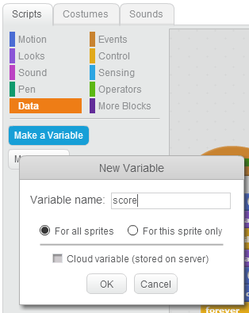
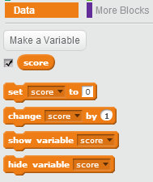
Data. Also called Variables
You can add changing data by “variables”
What data might you want in PONG or Bat Away?
Maybe score, high score, timer, ball count
Quick change: Add the score (a ‘touch’ count)

Slide 19
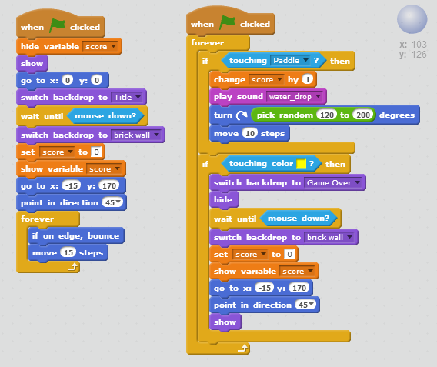
Here’s my score code
Score = times the paddle is hit
All this is on the ball, and nowhere else
Look at the orange blocks.

Slide 20
“Secret” Messages (events to broadcast and receive)
Sprites don’t talk to each other
(think of pong’s ball and paddle)
BUT, you can add your own secret message
Broadcasting and Receiving Messages is better
Could it make PONG better?
The paddle doesn’t know if the ball goes out of bounds. It could disappear or stop moving.
The “game” doesn’t know if it is over. Messages are a pretty good way to tell everything ‘game over’

Slide 21
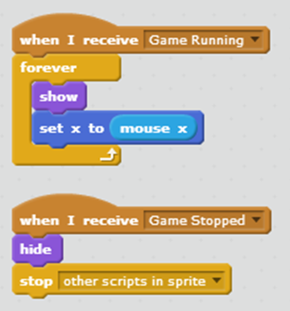
My messages for Pong
I added “Game Running” and “Game Stopped”
What do you think these scripts do (and what sprite are they on?)

Slide 22


Importing
You can import images and sounds
Images will often be bitmaps.
You can import sounds
You can edit sounds (stock and imported)

Slide 23
Advanced features are out there
You might want to add ‘more than one ball’
Cloning can turn Pong into Breakout
http://scratch.mit.edu/projects/10101023/
There’s a special type of data called a ‘list’
I found a quiz (next) that would be better as a list.

Slide 24
Review Quiz!
Ignore question 2, 9
Ugly spelling error in 8, 16
http://scratch.mit.edu/projects/2157361/
Want to change the quiz?

Slide 25
Other resources wiki.scratch.mit.edu/wiki/Alternatives_to_Scratch
UC Berkeley has Snap. Deeper programming
http://byob.berkeley.edu/
Doesn’t require Flash (so works on tablets)
Alice is a program that does better story telling (it has a timeline) and does 3D. It also exposes ‘real’ java programming. To me, the usability was lacking.
Unity3D is a 3d world game engine used by companies and people to make games.

